Slide 1
Exercise 6
Green Algae and Seedless Plant Diversity

Slide 2
Labs 6 and 7 follow the evolutionary relationships among members of the Plant Kingdom, including their algal relatives. Lab 6 examines the plants that do not produce seeds. You should be able to classify these specimens into their respective phyla. As you look at these specimens and identify their parts, keep in mind the basic pattern of the alternation of generations and the changes that have occurred to allow plants to live on land. For example, in addition to identifying structure and function, ask yourself questions such as, "Is this structure part of a sporophyte or a gametophyte?“, “Are the cells haploid or diploid?” and "Are any of these structures adaptations to living on land?"

Slide 3
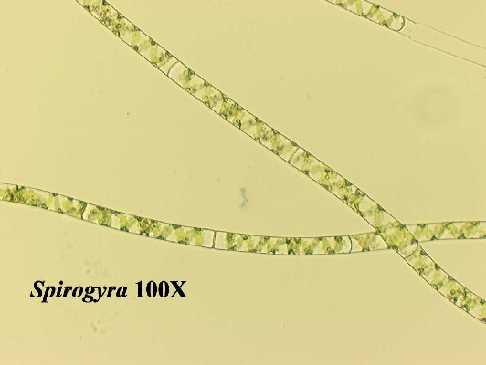
Live Spirogyra 100X

Slide 4
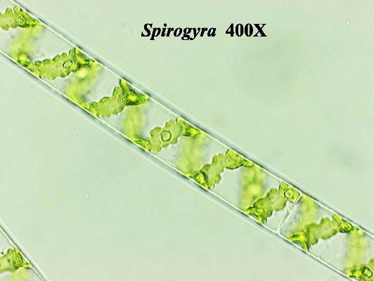
Live Spirogyra 400X

Slide 5
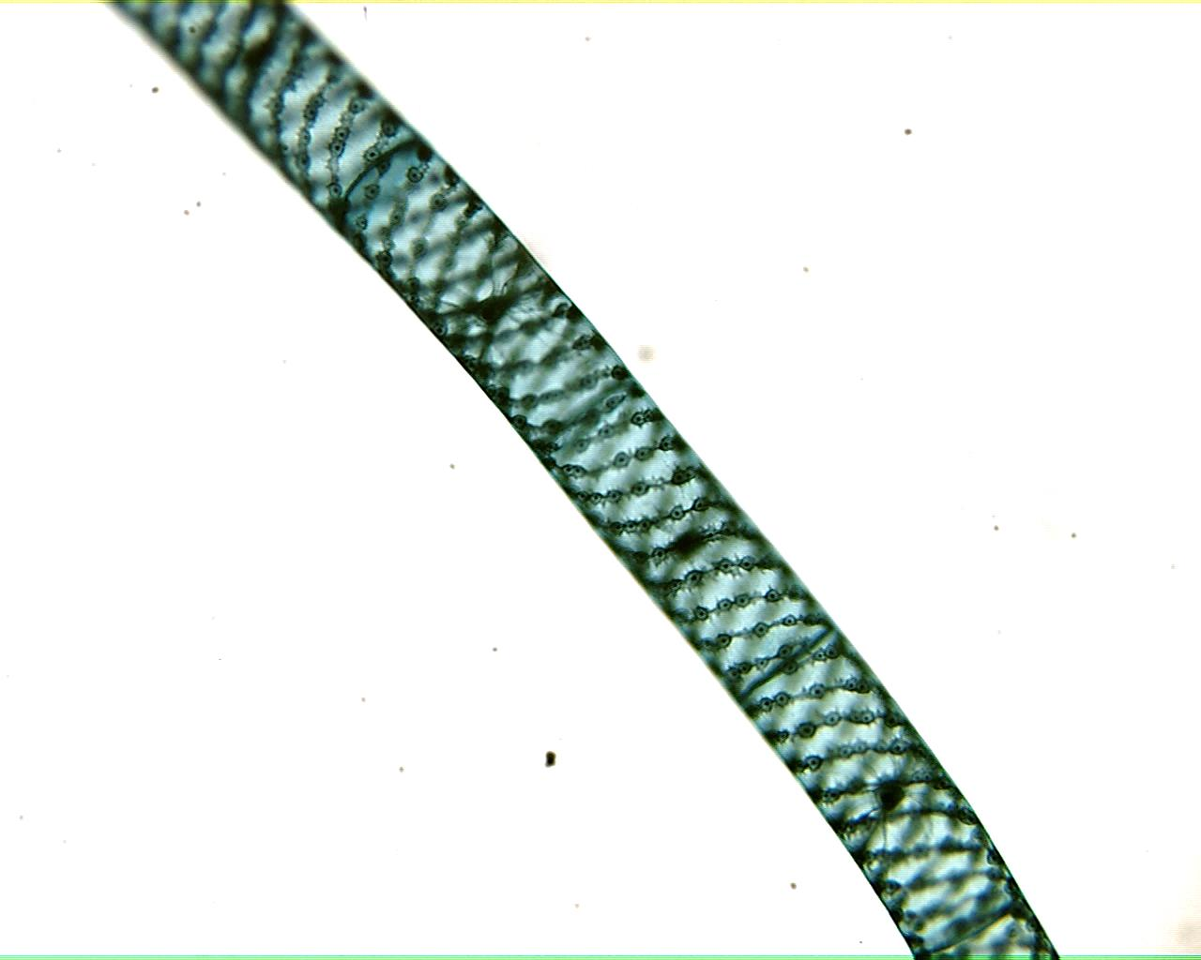
Spirogyra 100X

Slide 6
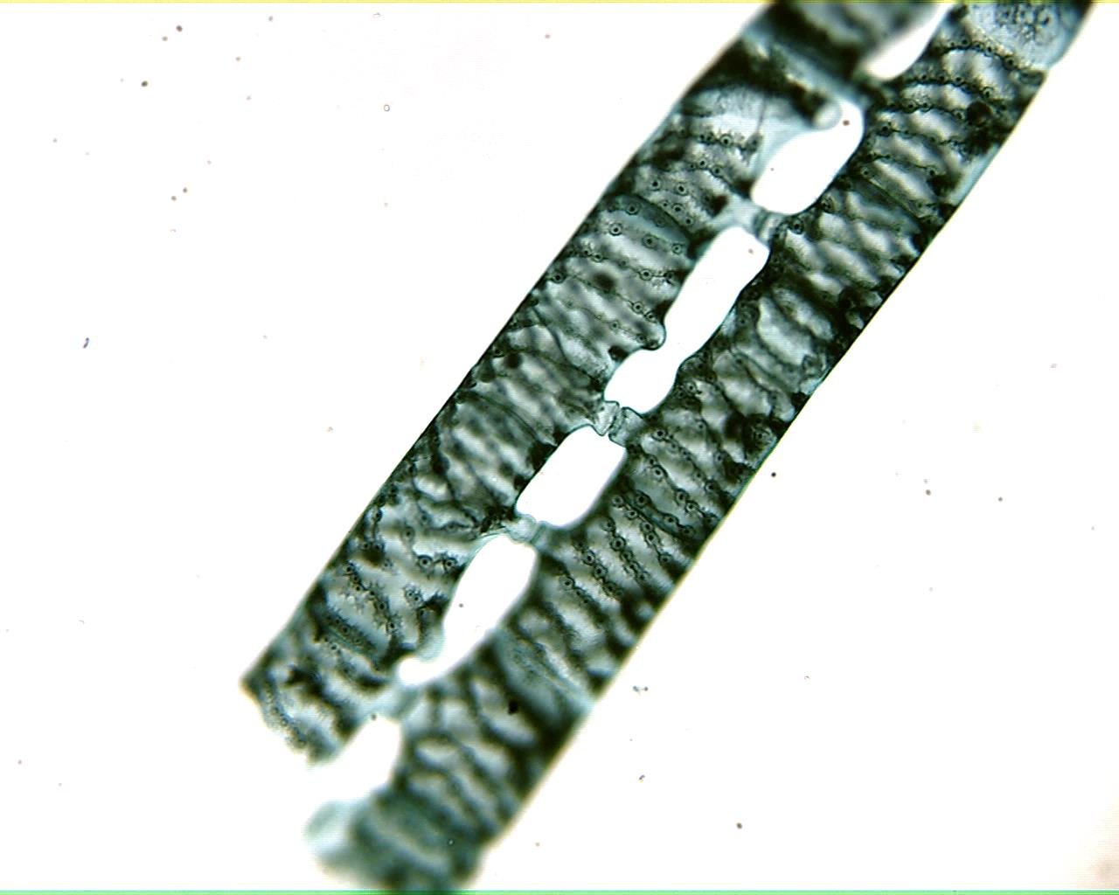
Spirogyra Conjugation 100X

Slide 7
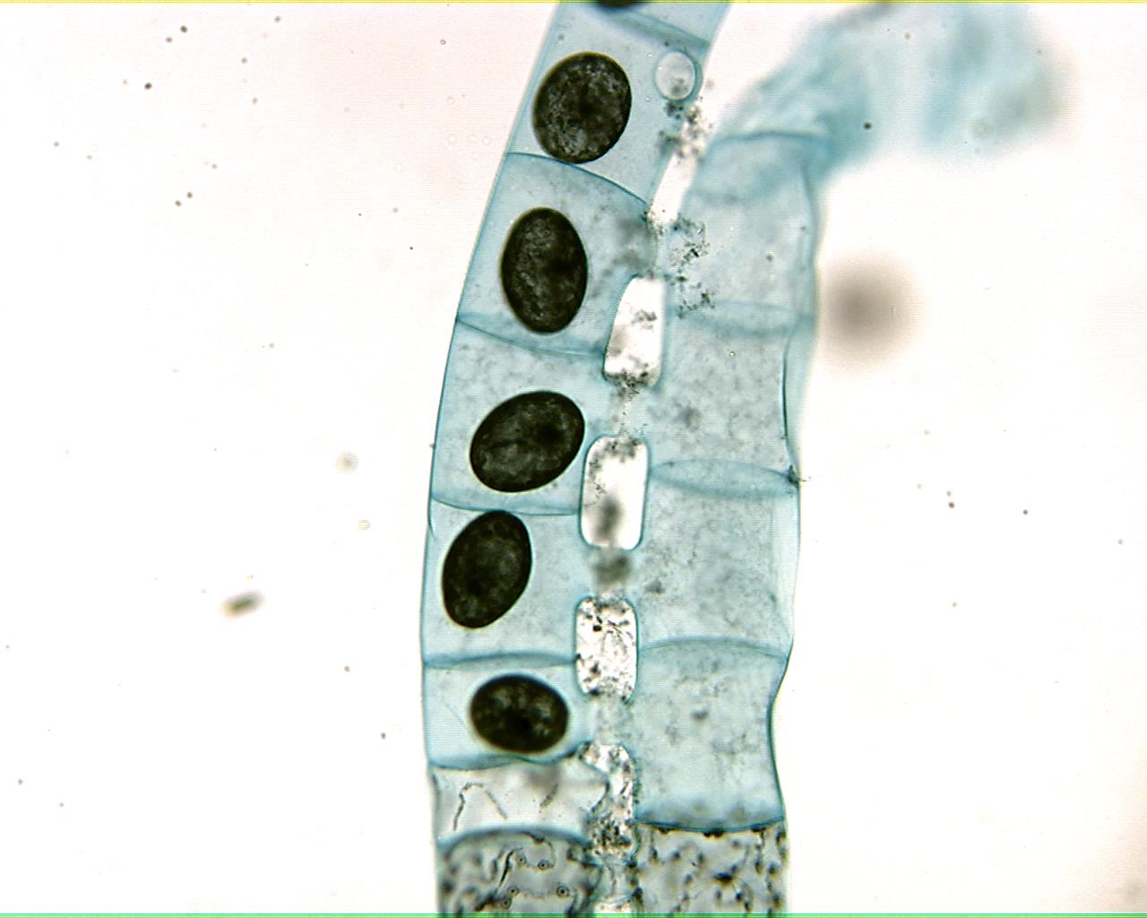
Spirogyra Zygospores 100X

Slide 8
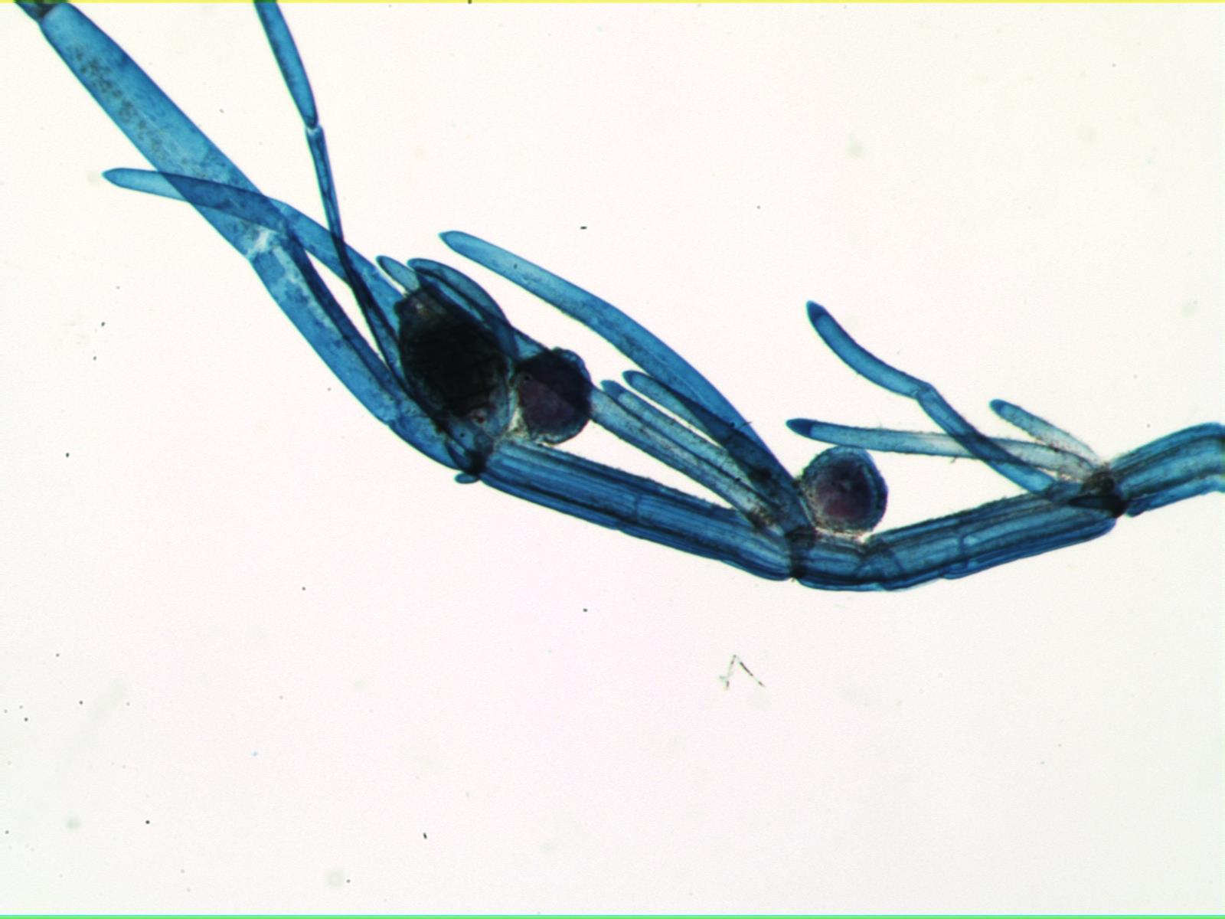
Chara 40X

Slide 9
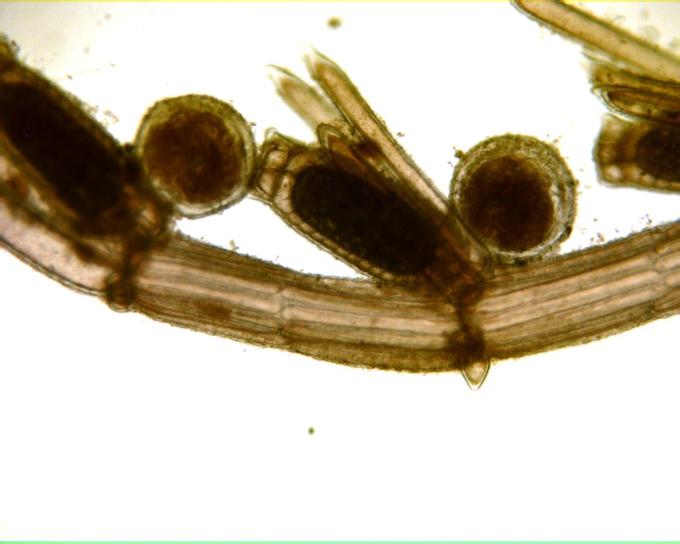
Chara 100X

Slide 10
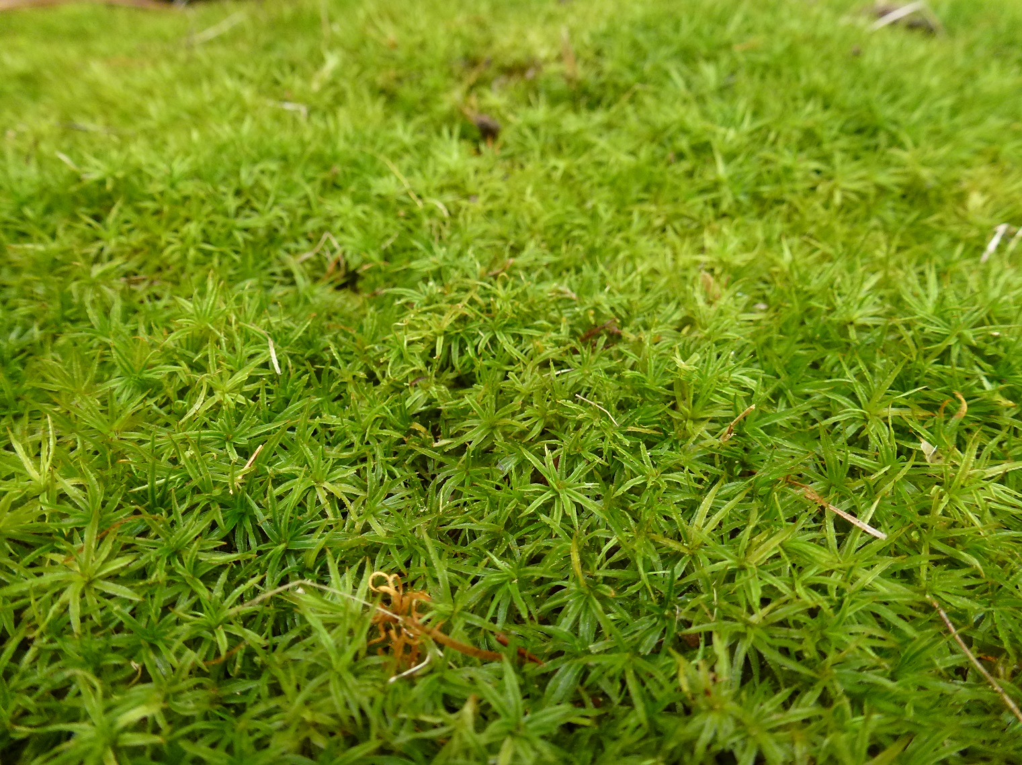
Living Moss

Slide 11
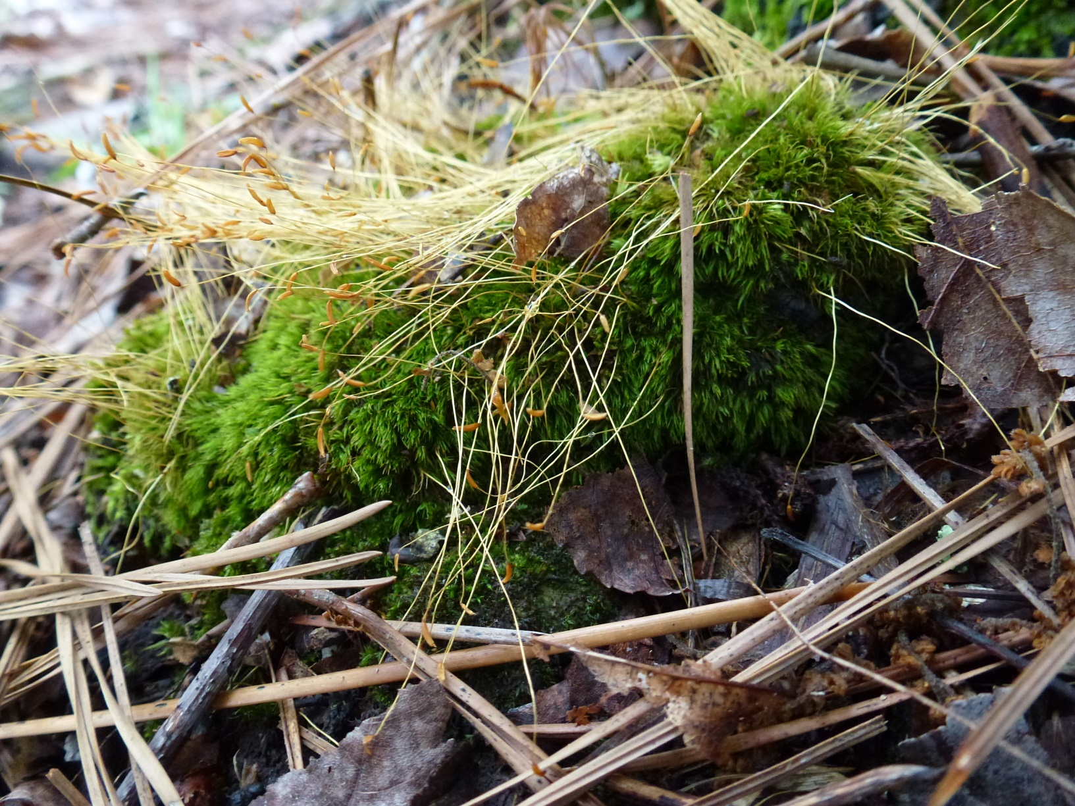
Moss Gametophyte and Sporophyte

Slide 12
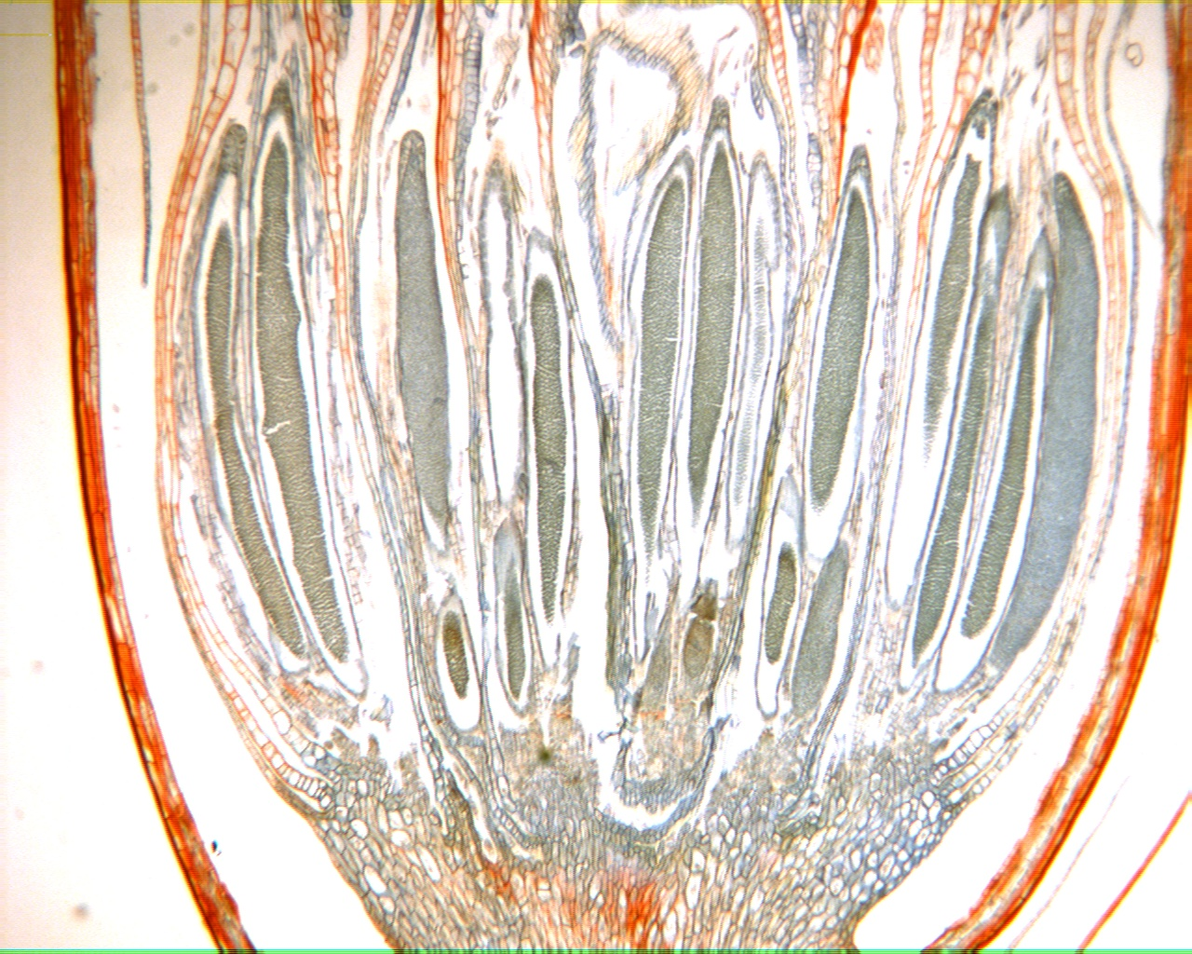
Moss Male Gametophyte 40X

Slide 13
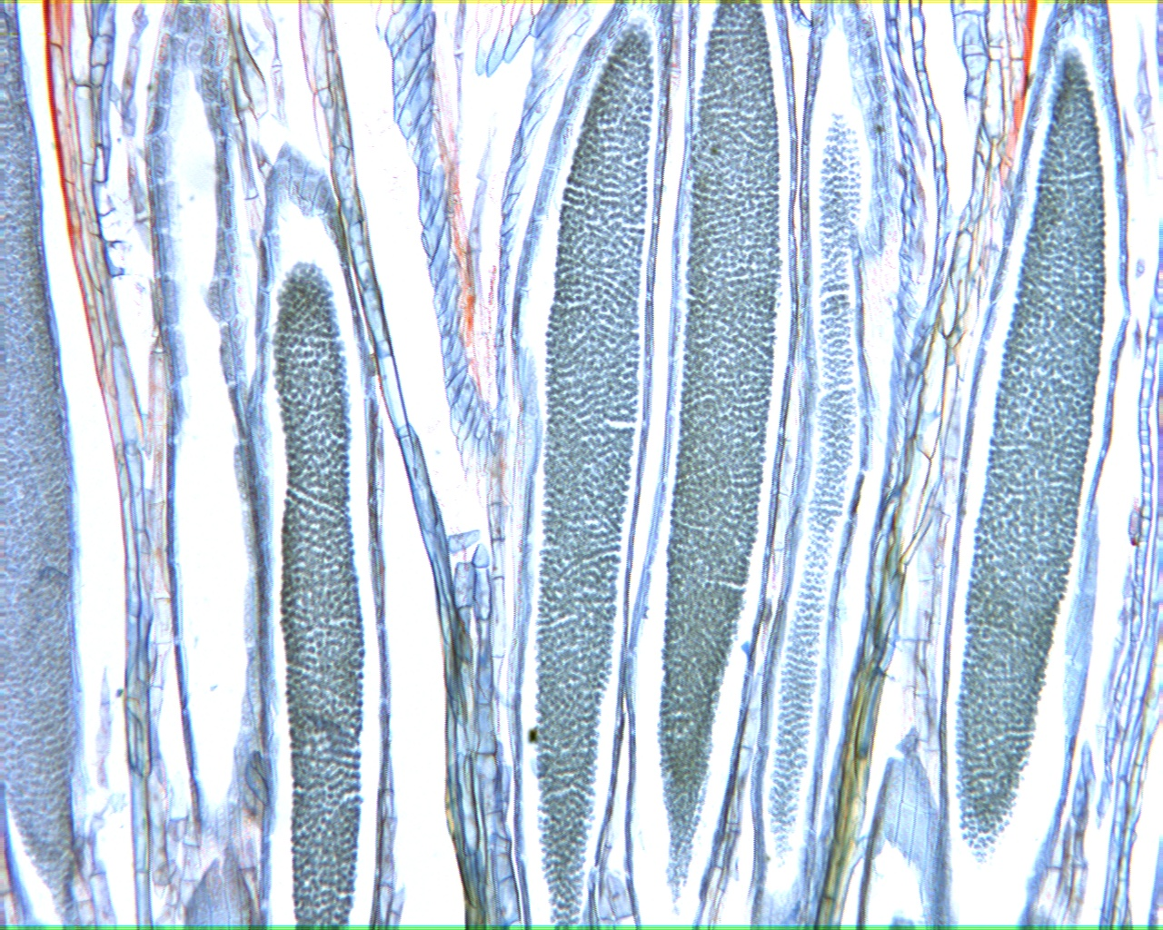
Moss Antheridia 100X

Slide 14
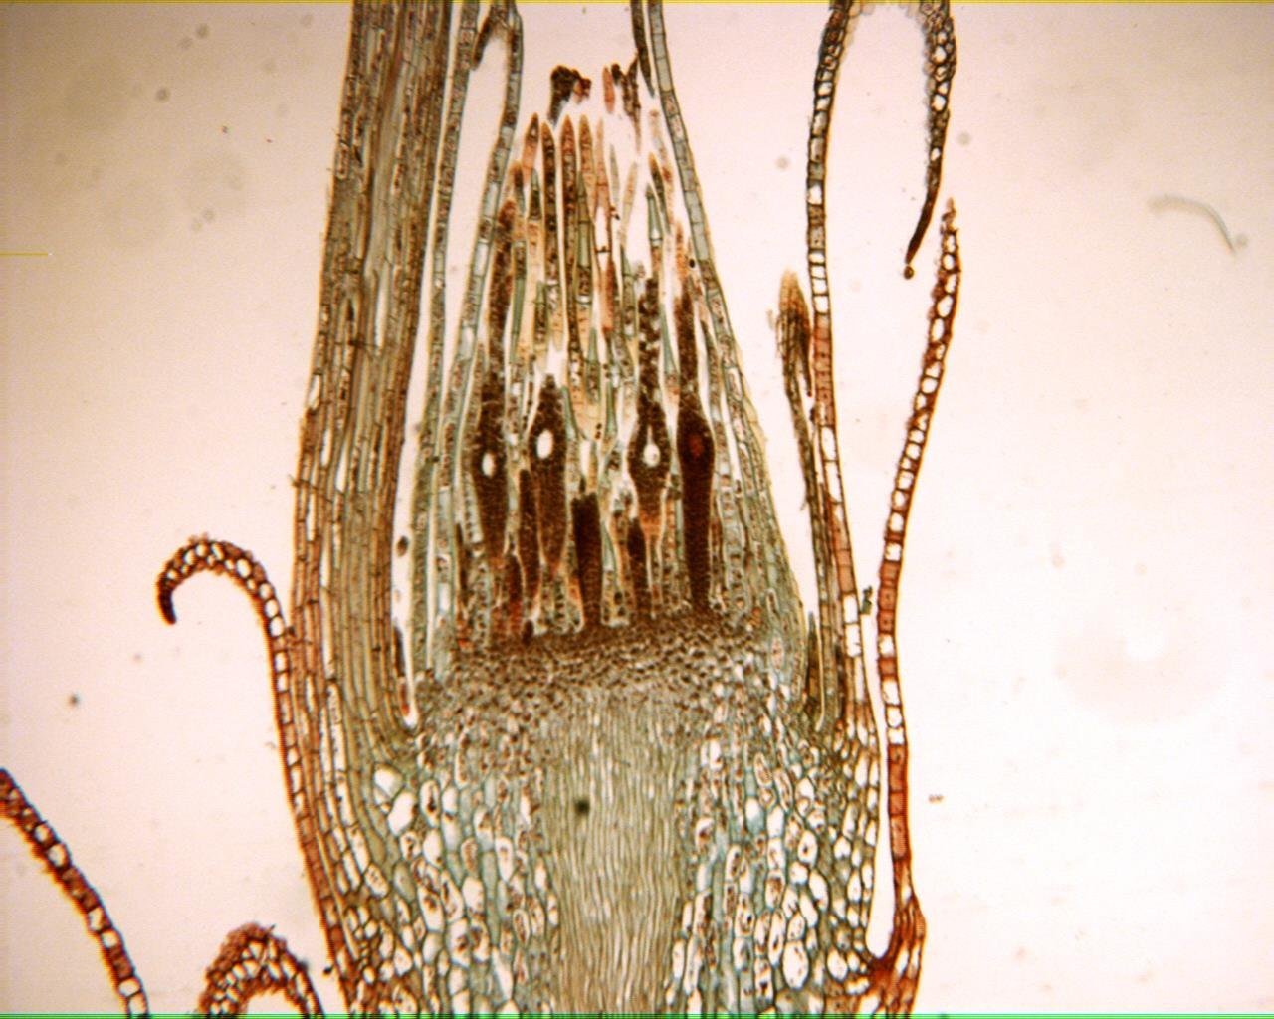
Moss Female Gametophyte

Slide 15
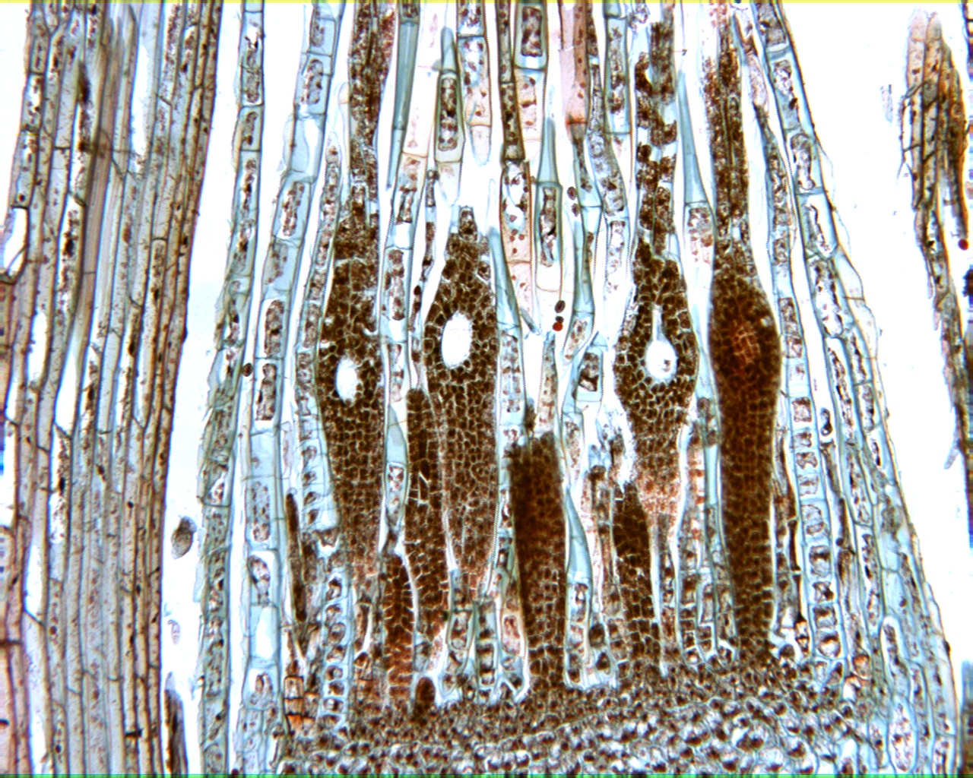
Moss Archegonia

Slide 16
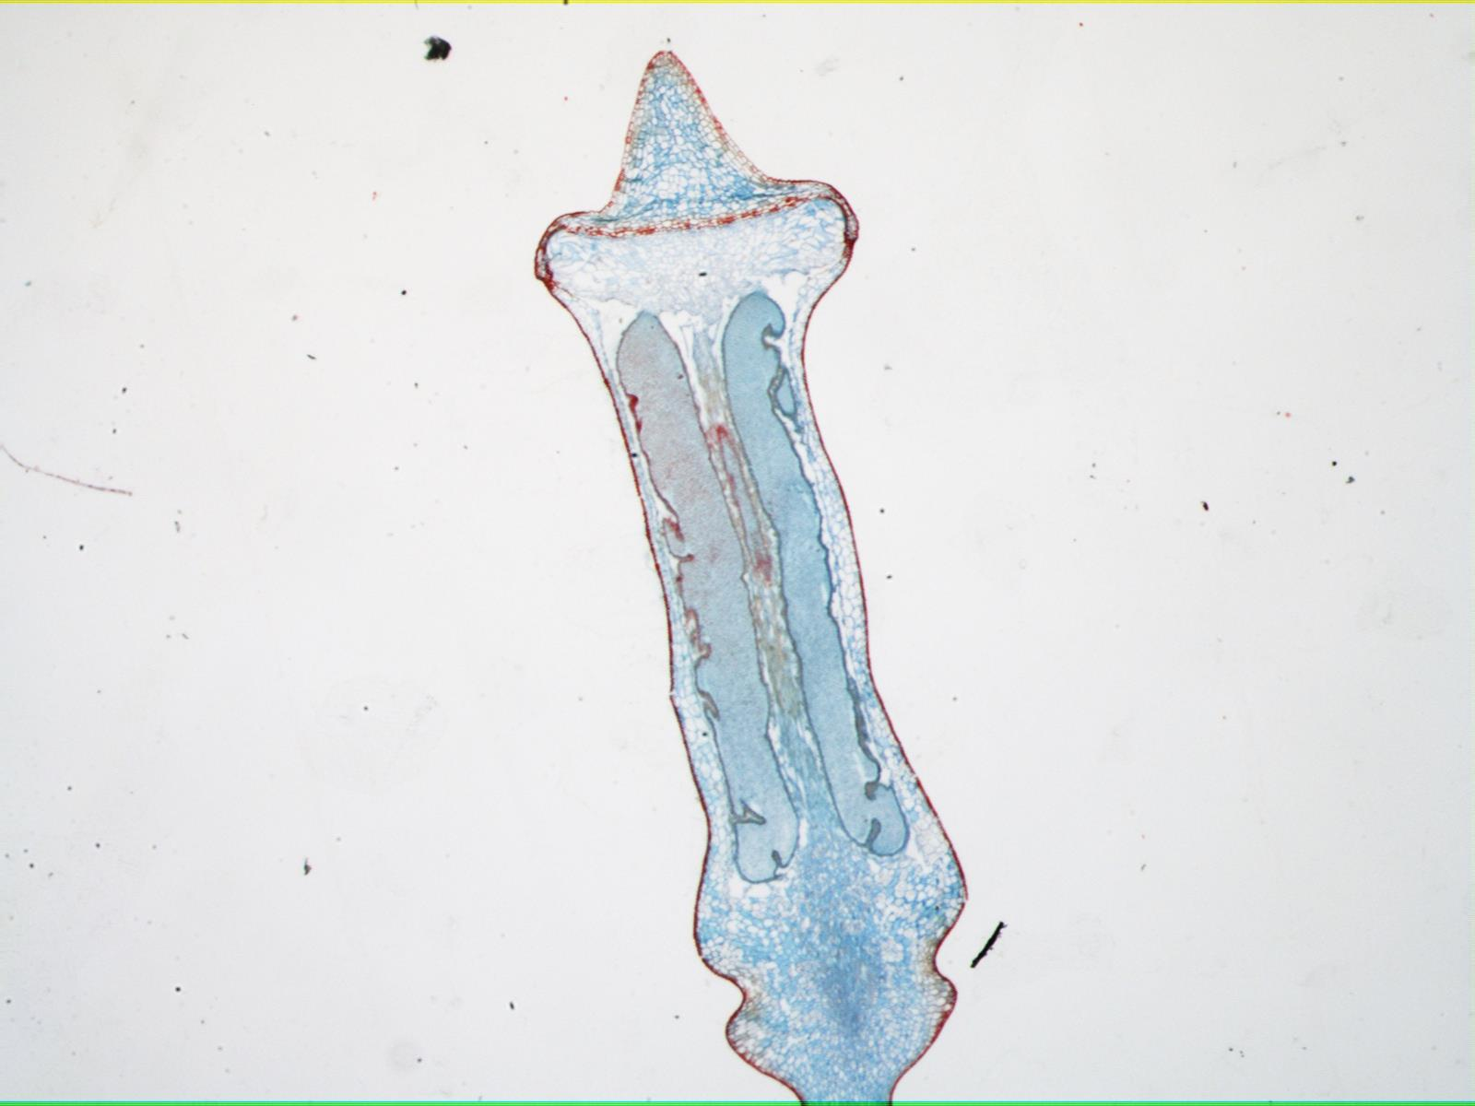
Moss Capsule

Slide 17
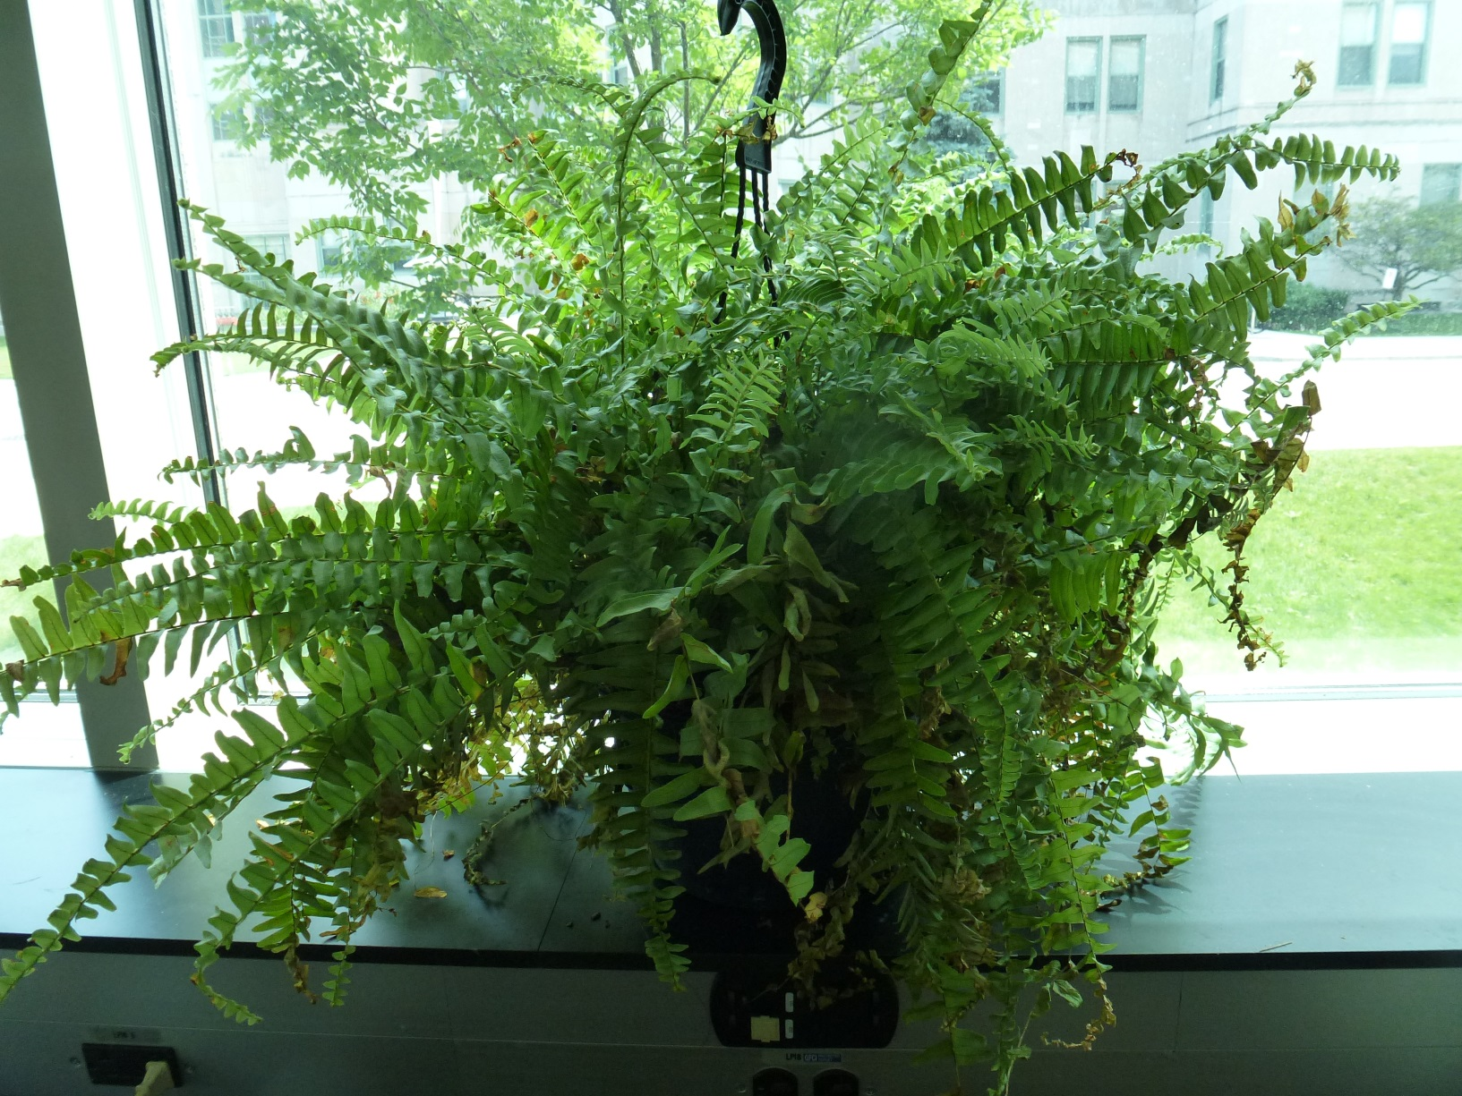
Fern Sporophyte

Slide 18
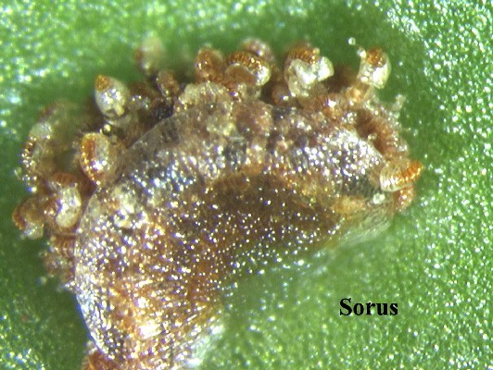
Fern Sorus

Slide 19
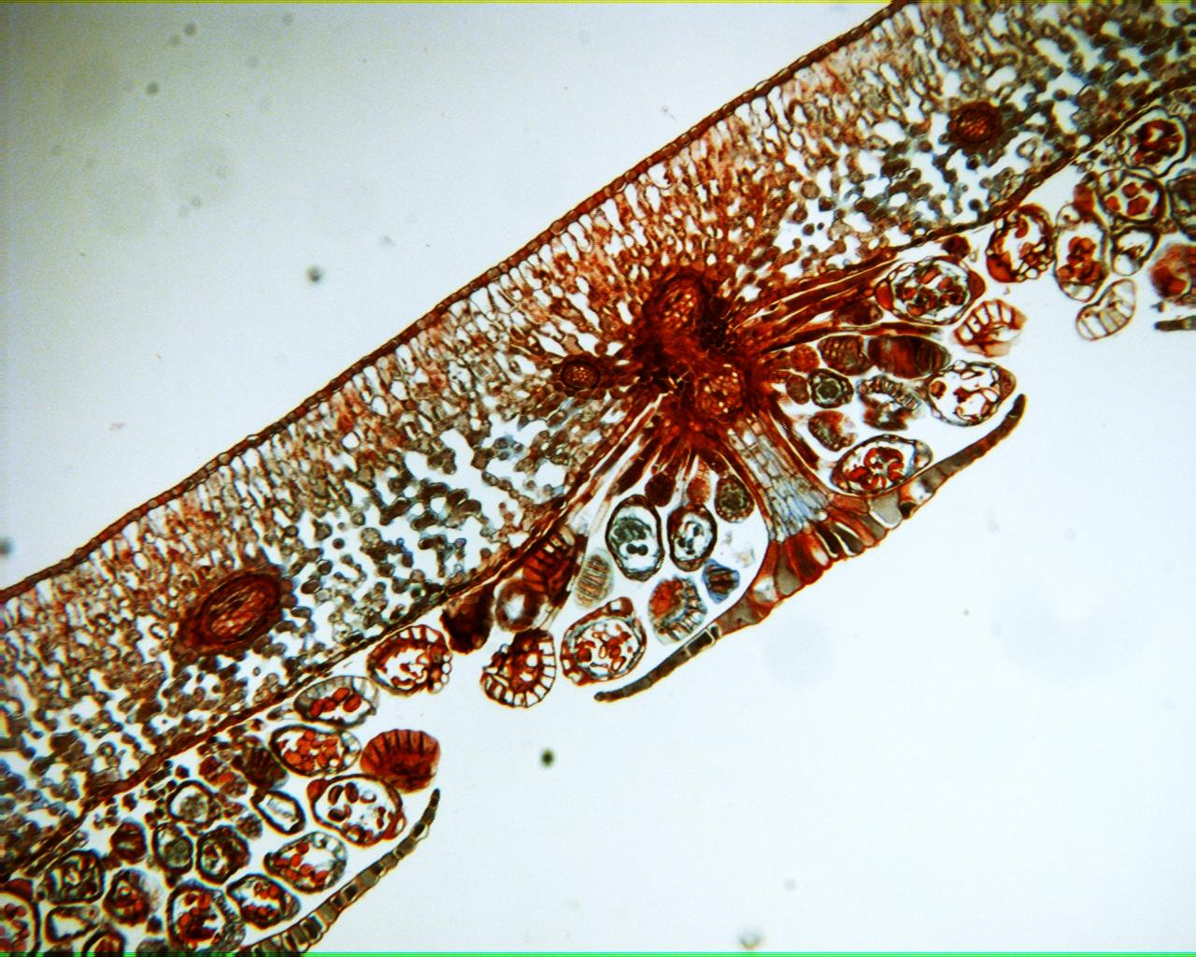
Fern Sorus cross section 100X

Slide 20
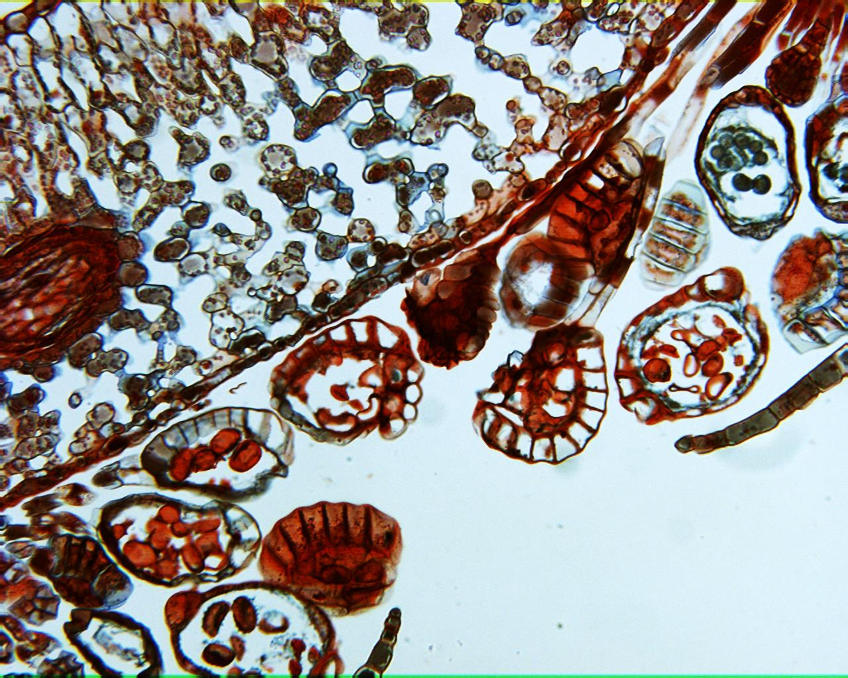
Fern Sorus cross section 40X

Slide 21
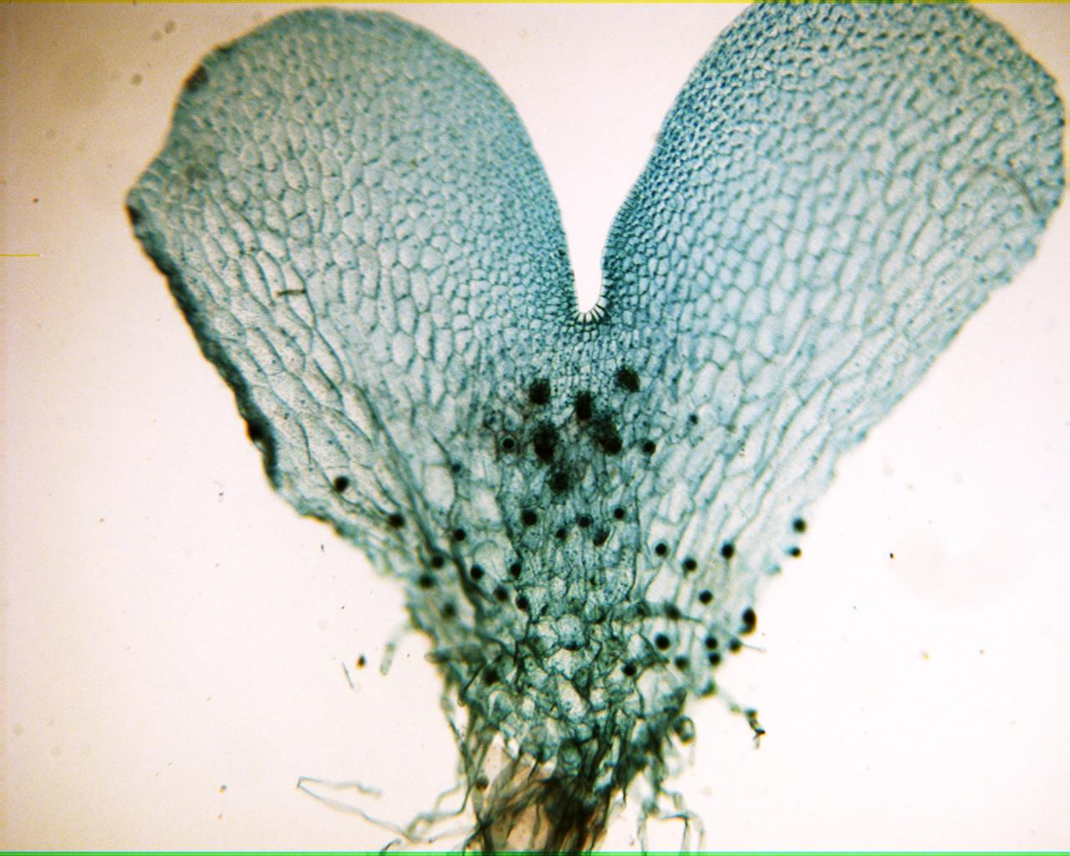
Fern Gametophyte 40X

Slide 22
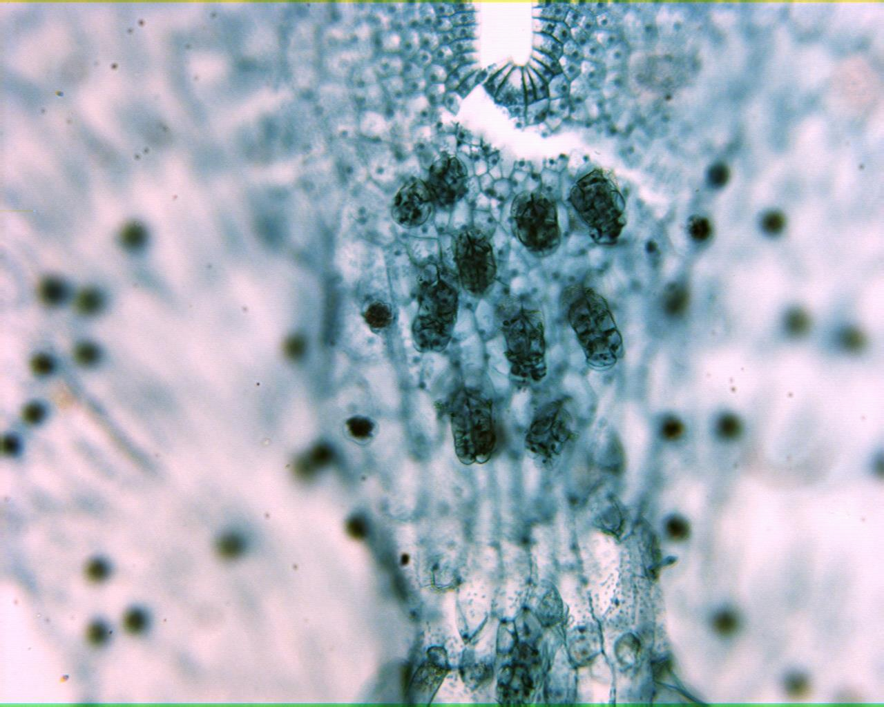
Fern Gametophyte 100X

Slide 23
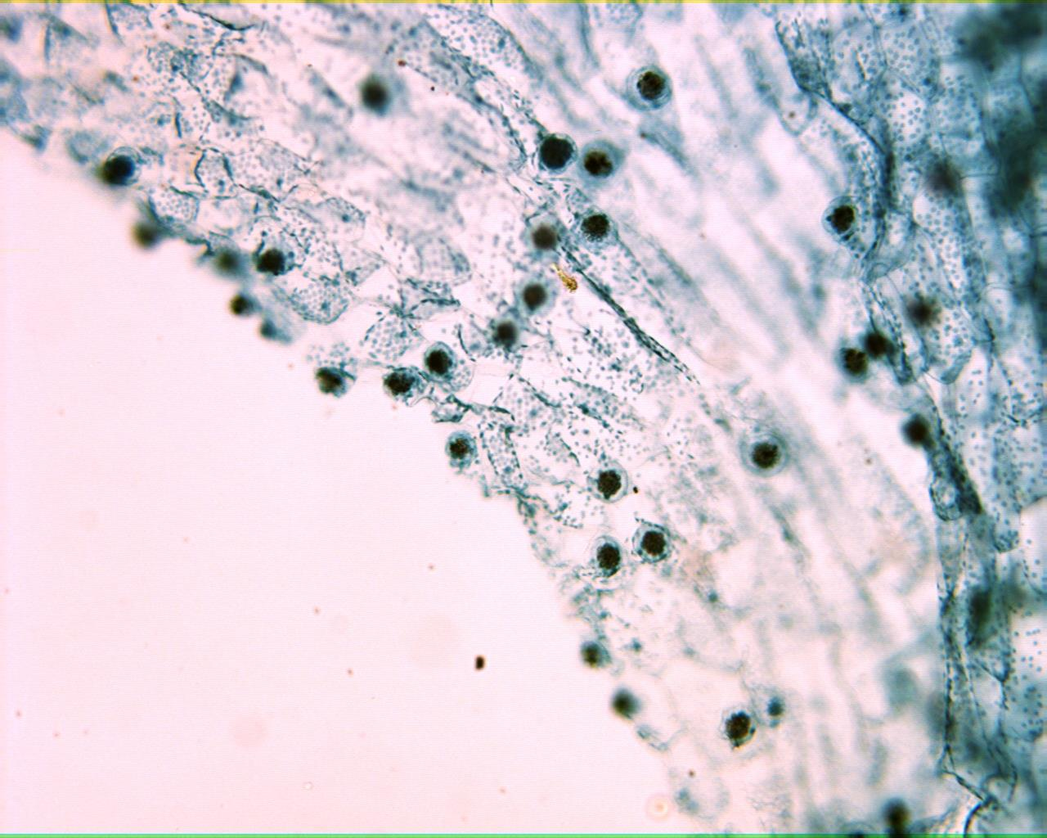
Fern Gametophyte 100X

